Slide 1
Emergency Class Manager - Design
Katie Hoskins, Tanya Peacock, Marcus Strange

Slide 2
Emergency Class Manager
Since this website will be used to keep track of students during emergency situations. Because of this, it is called the “Emergency Class Manager”

Slide 3
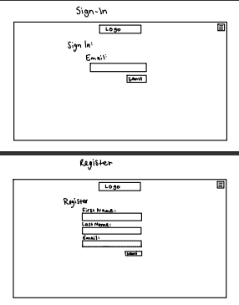
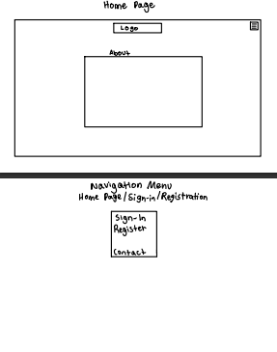
Storyboard/Design -
Home, Sign In, Register

Slide 4
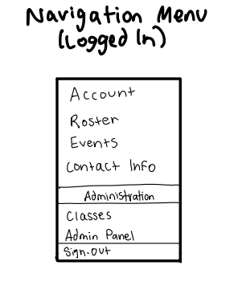
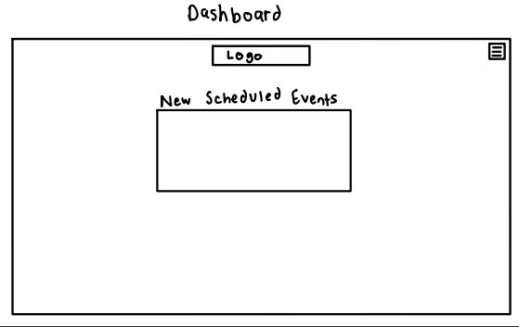
Storyboard/Design - Dashboard and Nav Menu

Slide 5
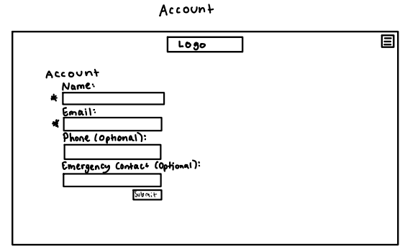
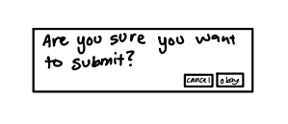
Storyboard/Design - Account

Slide 6
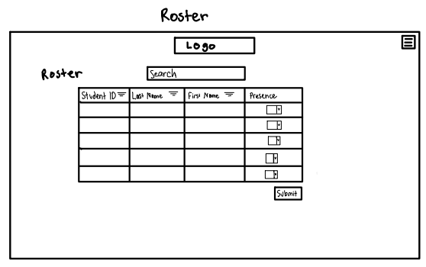
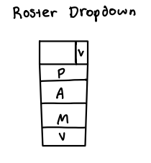
Storyboard/Design - Roster

Slide 7
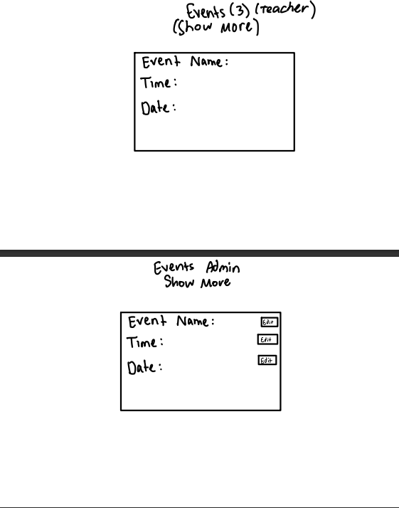
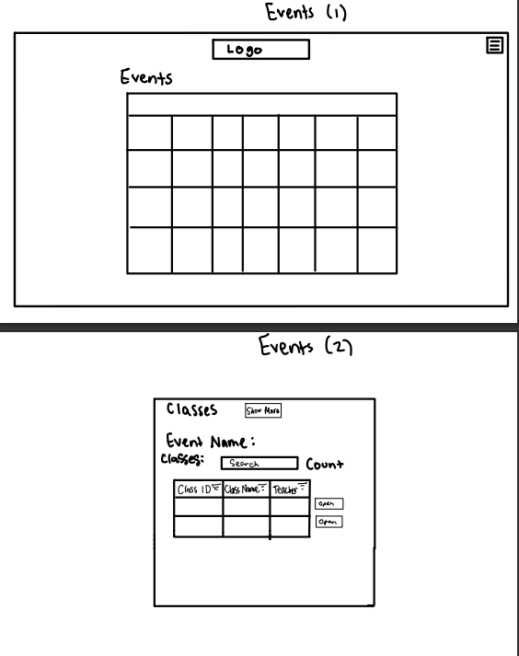
Storyboard/Design - Events

Slide 8
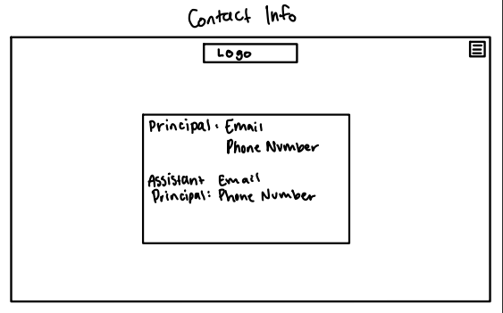
Storyboard/Design - Contact Info

Slide 9
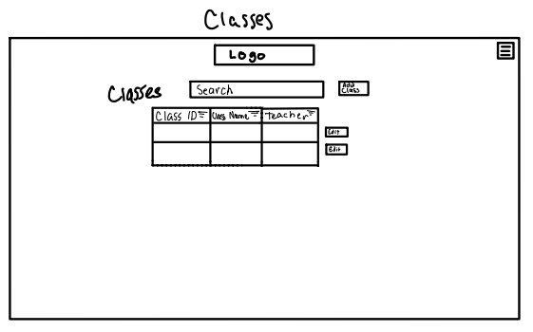
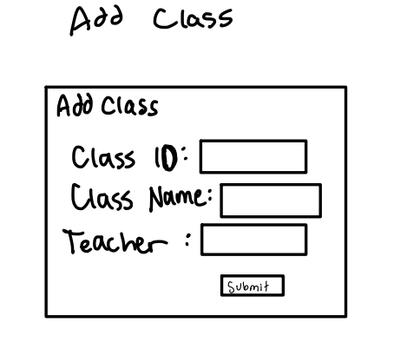
Storyboard/Design - Classes

Slide 10
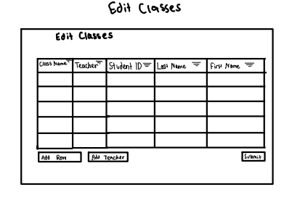
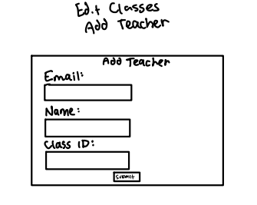
Storyboard/Design - Edit Classes

Slide 11
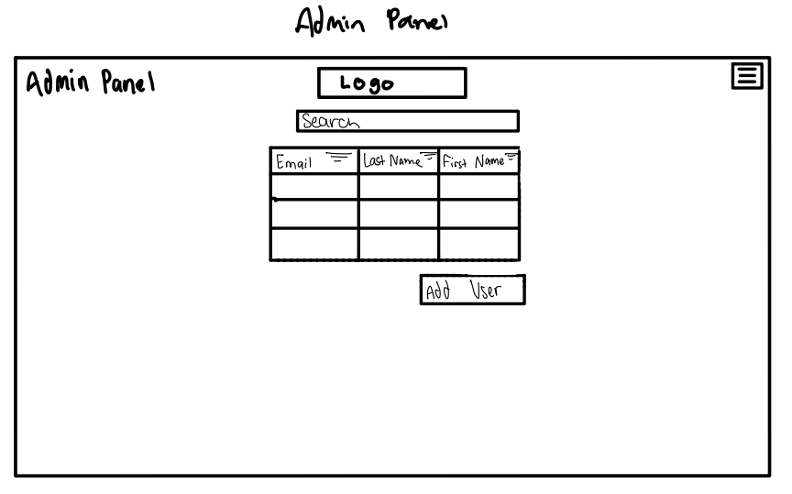
Storyboard/Design - Admin Panel

Slide 12
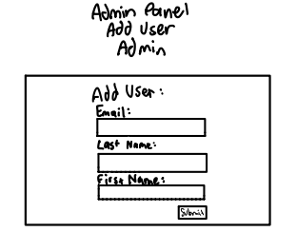
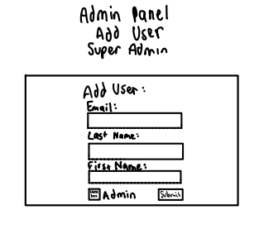
Storyboard/Design - Add User (Admin Panel)

Slide 13
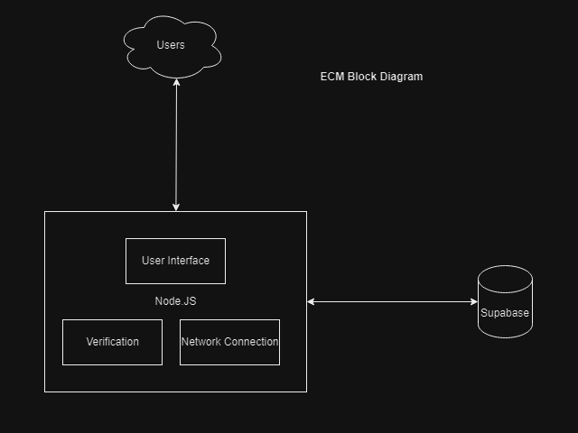
Block Diagram

Slide 14
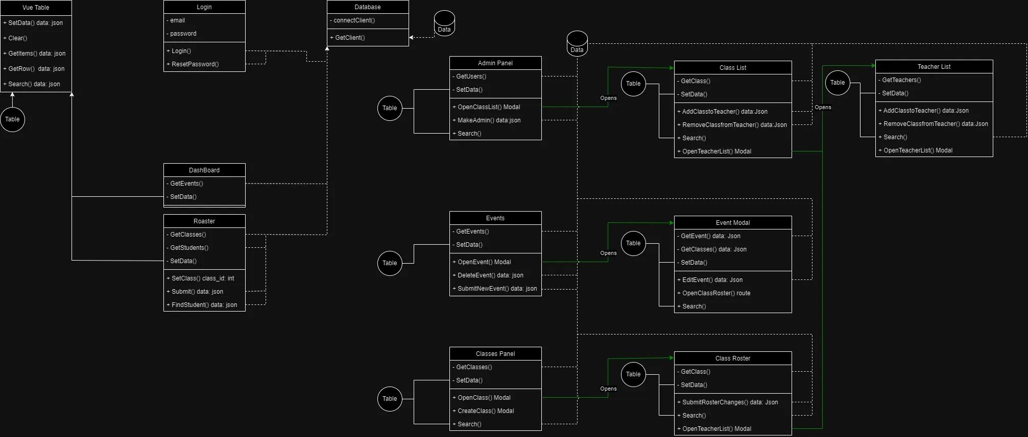
Component Diagram

Slide 15
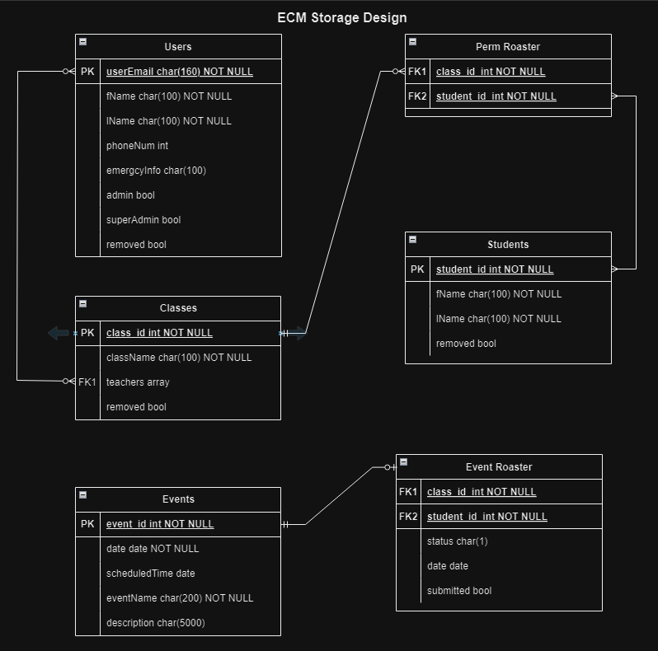
Database Design

